Slide 1


Slide 2

STAR BURSTING
Course Code : MSTS502P
Course Title :
Credits : 1
Prerequisites : NA
Antirequisites : NA

Slide 3

Definition
Starbursting is a form of brainstorming that focuses on generating questions rather than answers.
It can be used iteratively, with further layers of questioning about the answers to the initial set of questions.

Slide 4

Starbursting is a brainstorming technique that helps teams evaluate and validate ideas by asking questions.

Slide 5

What is starbursting?
Starbursting is a systematic brainstorming method that focuses on asking questions rather than immediately seeking answers to assess new ideas.
The goal is to generate key questions based on a simple but structured brainstorming framework modeled in the shape of a star.

Slide 6
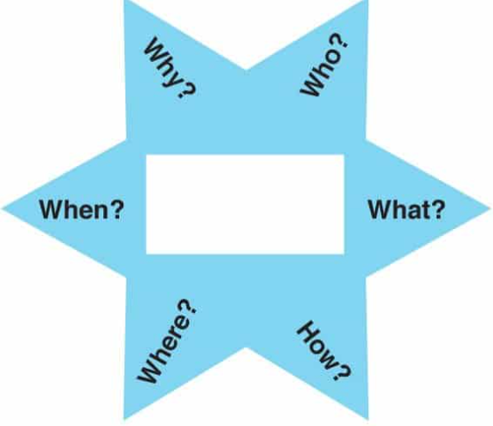
Starbursting requires you to ask six different types of questions:
Who
What
How
Where
When
Why.
By covering all areas, Starbursting is a comprehensive and systematic questioning exercise that you can use every time you explore a new idea.

Slide 7
Example
A colleague suggests a new design of ice skating boot. One question you ask might be "Who is the customer?"
Answer: "Skaters".
But you need to go further than this to ensure that you target your promotions accurately: "What kind of skaters?"
Answer: "Those who do a lot of jumping, who need extra support".

Slide 8
Why would you use starbursting
Starbursting is a great technique for decision making and problem solving.
It helps teams explore solutions by asking deeper questions that enable them to strategically plan and execute their ideas more effectively.
In other words, by asking the right questions, teams can ensure they produce the right solutions.

Slide 9

Starbursting helps teams brainstorm which questions to ask so they can confidently (and thoroughly) test the validity of the idea itself.

Slide 10
The technique is intended to generate many questions under each point—often dozens per group.
This helps the team assess new ideas in a systematic and iterative way, providing the foundation for good decision making and a clear direction for moving forward.

Slide 11
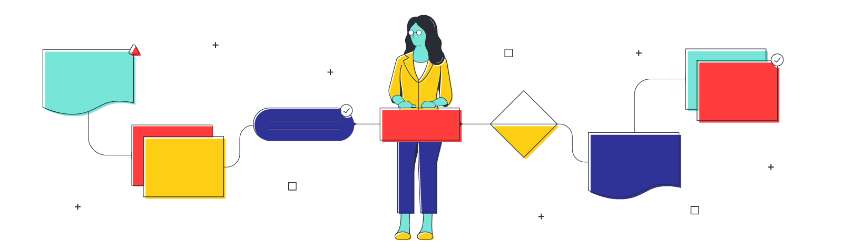
How to use the starbursting
Starbursting isn’t just effective, it’s surprisingly simple. Follow these five steps to use the starbursting method:

Slide 12
1. Outline a six-pointed star
The first step is to map out your star with six points, leaving space in the center. You can draw it on paper, a whiteboard, or a shared digital canvas.
Depending on how you want to approach the session, you can work from one shared model or have each team member fill in their own star individually and then share their questions with the group.

Slide 13
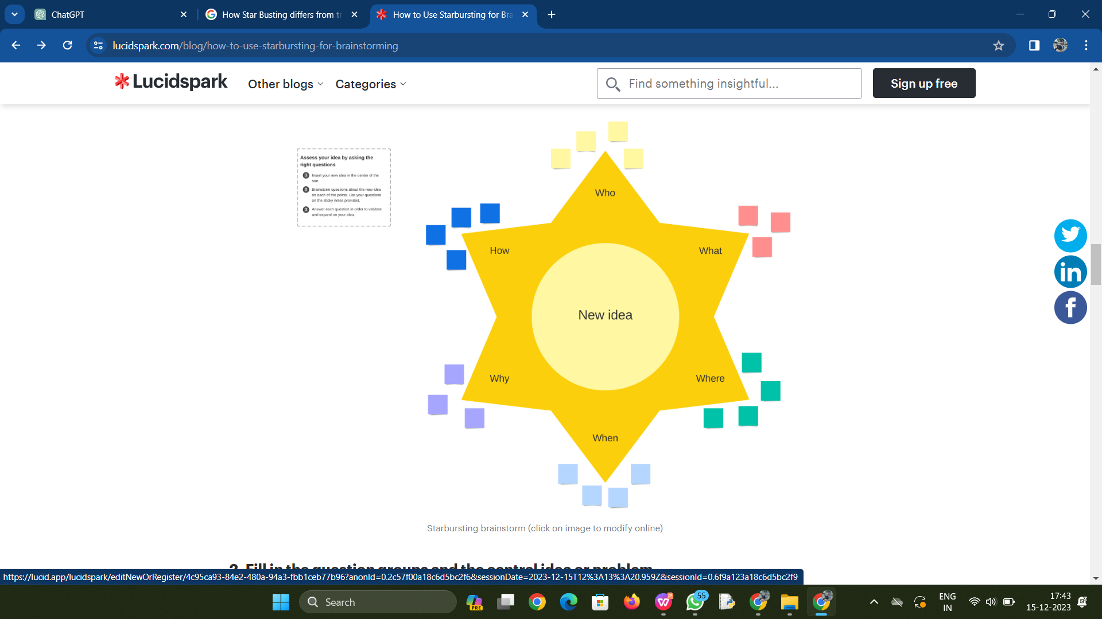

Slide 14
2. Fill in the question groups and the central idea or problem
Once your star is outlined, fill in the question groups (already provided in the template above)
one per point on the star:
Who
What
When
Where
Why
How
At the center of the star, write down the main idea or problem you’ll be focusing on for this brainstorming session.

Slide 15
3. Assign a facilitator
The facilitator is in charge of managing the discussion so that everyone stays on task and uses the time effectively.
This is especially important for an open-ended method like starbursting where the group is asking questions that can lead the discussion down rabbit holes.
It is the facilitator’s role to assess relevancy and decide how to address questions.

Slide 16

Sometimes this means tabling questions for later or redirecting the group to focused questions that are more on target.

Slide 17
4. Brainstorm questions under each point.
Start brainstorming questions for each group. For example, under “Who” you might ask:
Who is the target audience or customer?
Who will work on this new product?
Who are our competitors?

Slide 18

Starbursting is intended to generate many questions, so encourage your team to share whatever comes to mind. You can filter through them as needed later.

Slide 19
5. Answer the questions as a team.
When you have enough questions for discussion, it’s time to start working through your list and systematically answering them.
This is when a facilitator will need to pay attention to the conversation to make sure the questions are relevant and the discussion stays productive.

Slide 20

By the end of your starbursting session, you should have a comprehensive list of questions (and answers) that add clarity and direction to your central idea or goal.

Slide 21

Tips for making the most of starbursting
Like any brainstorming method, starbursting requires careful moderation of people and time management.
Keep your team on task and get the most out of your starbursting meetings with these tips:

Slide 22
1.Set time limits.
Starbursting is open-ended by nature, which can easily lead to wasted time or tangential discussions.
Plus, since there are an infinite number of questions you could imagine, it’s helpful to set a time limit on how long the team can brainstorm.

Slide 23

Time limits help keep minds focused on the task and prevent overwhelm.

Slide 24

2.Break the session into two meetings.
Don’t be afraid to break up your starbursting session into two meetings: one for asking questions and the other for answering them.
This gives the team a chance to mull over their ideas, and come ready to participate fully each time.

Slide 25

3. Have individuals write down questions silently before sharing as a group.
As with other brainstorming methods or group meeting dynamics, it’s easy for starbursting to become a discussion dominated by just a few voices.
To ensure all personalities have a chance to contribute equally, consider having your team write down their questions silently. Then go around the table and have each person share their ideas.

Slide 26
4.Have the team add to the chart over a few days
Another approach is to share the starbursting diagram for team members to add to over time.
For instance, you can leave the chart on a whiteboard in a common room and have team members add sticky notes with their questions on it throughout the week.
This gives the team time to think through the idea more thoroughly and gives people a chance to brainstorm when their mind is most focused—which is different for everyone.

Slide 27
Conclusion
Starbursting is a vital method for problem-solving and decision-making at a later stage as it.
Focuses on generating questions in a systematic way while understanding all aspects of the project
Looks at all the available options in the design template
Generates and evaluates all the ideas and finds possible answers

Slide 28

THANK YOU

